Slide 1
A MODERN SYSTEM OF EDUCATION AND TRAINING
FOR INCREASING THE LABOUR MARKET EMPLOYABILITY

Slide 2
I. Making Adult Learning System

Slide 6
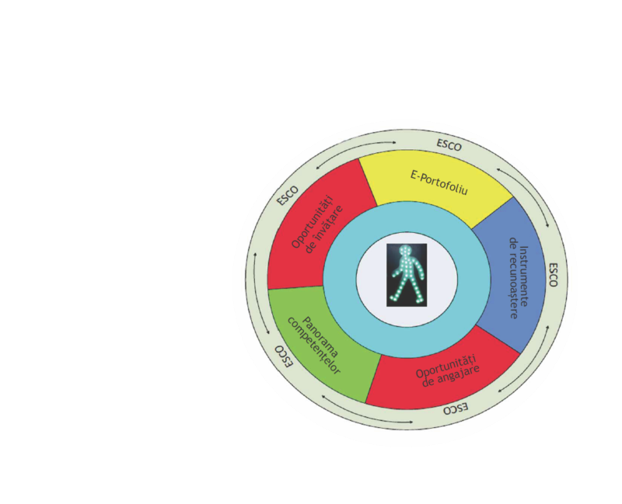
To a new solution in 2017 based on individual and its needs
A unique integrated system:
n
e
tot
p
p
a
a
r
e
c
r
u
a
r
-Information
- Counseling
– Formation
- Recognition
and
- Employability
ț
s
ă
u
v
l
v
Î
i
e
ț
i
i
Lifelong Learning process
- Professional career
- Individual development

Slide 7
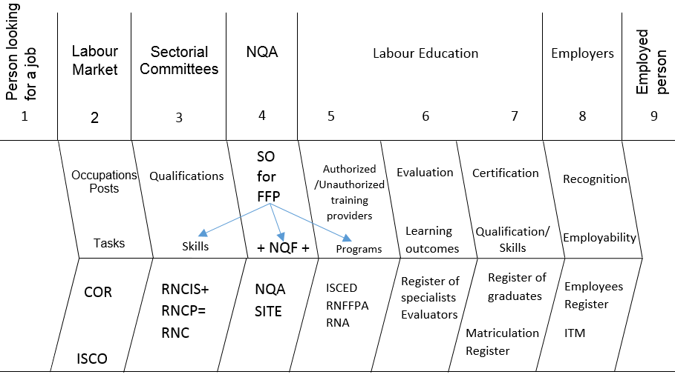

Slide 8
II. International Standard Clasiffication of Education
- ISCED – F 2013 -

Slide 9
Broad field | Narrow field | Detailed field
00 Generic programmes and qualifications | 001 Basic programmes and qualifications 002 Literacy and numeracy 003 Personal skills and development | 0011 Basic programmes and Qualifications 0021Literacy and numeracy 0031 Personal skills and development
01 Education | 011Education | 0111 Education science 0112 Training for pre-school teachers 0113 Teacher training without subject specialisation 0114 Teacher training with subject specialisation

Slide 10
Broad field | Narrow field | Detailed field
02 Arts and humanities | 021 Arts | 0211 Audio-visual techniques and media production 0212 Fashion, interior and industrial Design 0213 Fine arts 0214 Handicrafts 0215 Music and performing arts
 | 022 Humanities (except languages) | 0221 Religion and theology 0222 History and archaeology 0223 Philosophy and ethics
 | 023 Languages | 0231 Language acquisition 0232 Literature and linguistics

Slide 11
Broad field | Narrow field | Detailed field
03 Social sciences, journalism and information | 031 Social and behavioural sciences | 0311 Economics 0312 Political sciences and civics 0313 Psychology 0314 Sociology and cultural studies
 | 032 Journalism and information | 0321 Journalism and reporting 0322 Library, information and archival studies

Slide 12
Broad field | Narrow field | Detailed field
04 Business, administration and law | 041 Business and administration | 0411 Accounting and taxation 0412 Finance, banking and insurance 0413 Management and administration 0414 Marketing and advertising 0415 Secretarial and office work 0416 Wholesale and retail sales 0417 Work skills
 | 042 Law | 0421 Law

Slide 13
Broad field | Narrow field | Detailed field
05 Natural sciences, mathematics and statistics | 051 Biological and related sciences | 0511 Biology 0512 Biochemistry
 | 052 Environment | 0521 Environmental sciences 0522 Natural environments and wildlife
 | 053 Physical sciences | 0531 Chemistry 0532 Earth sciences 0533 Physics
 | 054 Mathematics and statistics | 0541 Mathematics 0542 Statistics
06 Information and Communication Technologies | 061 Information and Communication Technologies | 0611 Computer use 0612 Database and network design and administration 0613 Software and applications development and analysis

Slide 14
Broad field | Narrow field | Detailed field
07 Engineering, manufacturing and construction | 071 Engineering and engineering trades | 0711 Chemical engineering and processes 0712 Environmental protection technology 0713 Electricity and energy 0714 Electronics and automation 0715 Mechanics and metal trades 0716 Motor vehicles, ships and aircraft
 | 072 Manufacturing and processing | 0721 Food processing 0722 Materials (glass, paper, plastic and wood) 0723 Textiles (clothes, footwear and leather) 0724 Mining and extraction
 | 073 Architecture and construction | 0731 Architecture and town planning 0732 Building and civil engineering

Slide 15
Broad field | Narrow field | Detailed field
08 Agriculture, forestry, fisheries and veterinary | 081 Agriculture | 0811 Crop and livestock production 0812 Horticulture
 | 082 Forestry | 0821 Forestry
 | 083 Fisheries | 0831 Fisheries
 | 084 Veterinary | 0841 Veterinary
09 Health and welfare | 091 Health | 0911 Dental studies 0912 Medicine 0913 Nursing and midwifery 0914 Medical diagnostic and treatment technology 0915 Therapy and rehabilitation 0916 Pharmacy 0917 Traditional and complementary medicine and therapy
 | 092 Welfare | 0921 Care of the elderly and of disabled adults 0922 Child care and youth services 0923 Social work and counselling

Slide 16
Broad field | Narrow field | Detailed field
10 Services | 101 Personal services | 1011 Domestic services 1012 Hair and beauty services 1013 Hotel, restaurants and catering 1014 Sports 1015 Travel, tourism and leisure
 | 102 Hygiene and occupational health services | 1021 Community sanitation 1022 Occupational health and safety
 | 103 Security services | 1031 Military and defence 1032 Protection of persons and property
 | 104 Transport services | 1041 Transport services

Slide 17

Thank You!
National Qalification Authority
Prof. univ.dr. Nicolae Postăvaru
www.anc.edu.ro

